Slide 1
Healthcare Analytics
Scenario-Based Data Analysis and Insights
By Monisha Raja

Slide 2
INTRODUCTION
Domain Introduction: Healthcare Analytics involves using data analysis to improve patient care, optimize operations, and enhance financial performance in healthcare.
Project Introduction: This project uses SQL to analyze healthcare data for meaningful insights, focusing on patient management, doctor performance, appointments, and revenue.
Objective: Optimize data usage in healthcare systems by extracting actionable insights through SQL techniques.

Slide 3
AGENTA
Introduction
Objectives
Approach
Key Tasks
Deliverables
Evaluation Metrics
Conclusion

Slide 4
Project Approach and ELT Process
ELT Approach: Extracted healthcare datasets → Loaded into MySQL → Cleaned & transformed using SQL queries
Data Cleaning
Replaced NULLs in contact fields.
Standardized name formats using UPPER().
Ensured data types (e.g., INT for Age).
Removed duplicate rows if any.

Slide 5
Project Approach and ELT Process
Data Structuring
Created relational structure with Primary and Foreign Keys across 5 core tables: Patients, Doctors, Appointments, Diagnoses, Medications.
ETL Approach [CSV Files] → [MySQL Upload] → [Cleaning with SQL] → [Ready for Analysis]

Slide 6
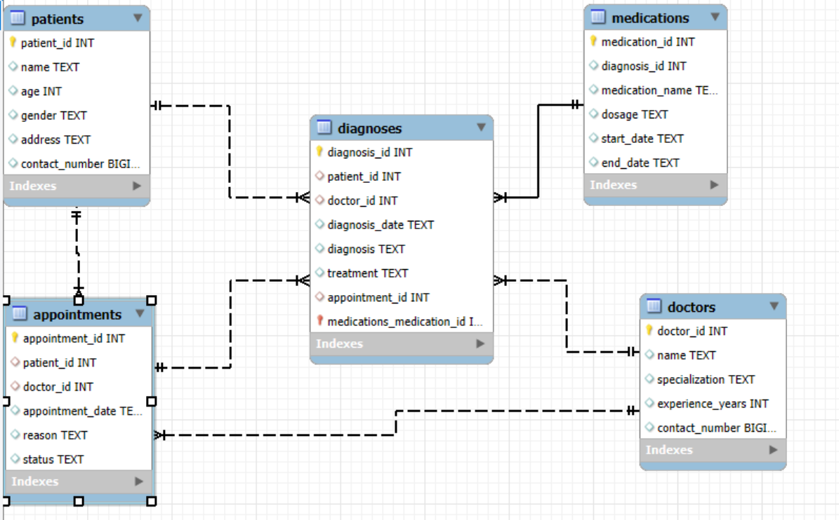
Relationship between Tables

Slide 7
Scenario 1
Appointment Breakdown

Slide 8
Objectives
Goal: Analyse which appointments are completed, and identify gaps or issues.
SQL Tasks:
✅ Task 1: Completed Appointments (Inner Join)
✅ Task 4: Mismatch Between Appointments and Diagnoses (Full Join)
✅ Task 2: Patients with No Appointments (Left Join + NULL)

Slide 9
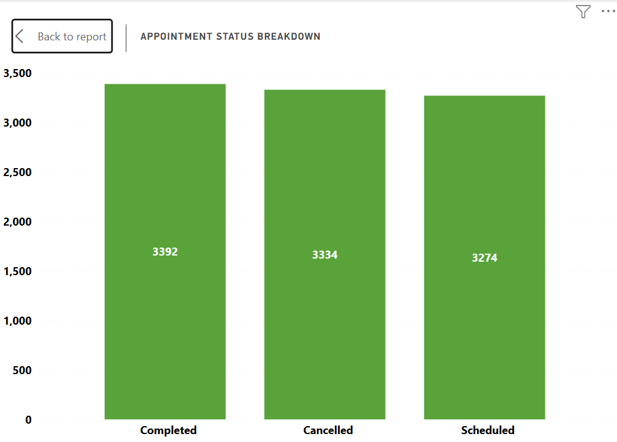
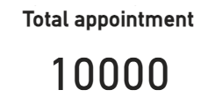
Appointments Breakdown
✅ 33.93% of appointments were completed successfully.

Slide 10

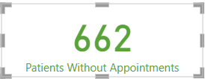
Patients with No Appointments
❌ 15% of patients never scheduled even one appointment.
Table used : patient, appointments

Slide 11
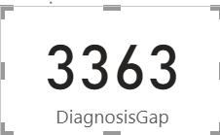
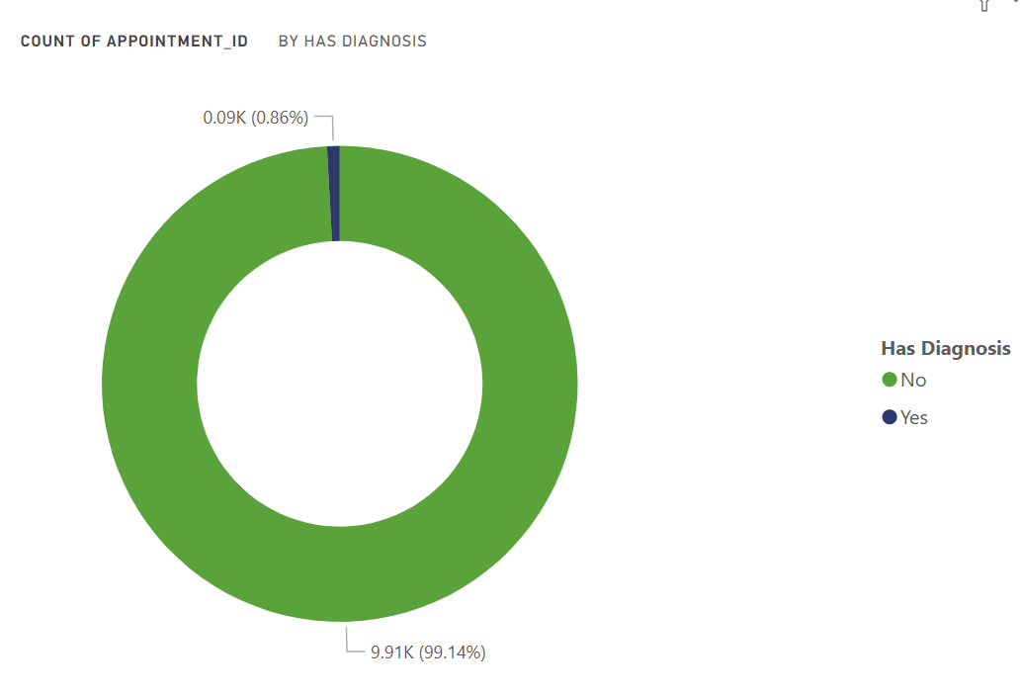
Diagnosis Gaps
Completed 3392
❌ 99.14% of appointments were not followed up with a diagnosis.
Table used : Diagnoses and Appointment.

Slide 12
Recommendations
Automated Reminders: Send SMS/email alerts to reduce no-shows.
Target Inactive Patients: Reach out to those without appointments and encourage check-ups.
Close Diagnosis Gaps: Ensure every appointment concludes with a diagnosis entry.
Flag Incomplete Records: Use dashboards to track and resolve missing diagnoses.
Incentivize Engagement: Offer discounts or rewards for regular attendance.
Data Audits: Conduct regular checks to improve data accuracy.

Slide 13
Scenario 2
Doctor performance Analysis

Slide 14
Objective
Goal: Evaluate doctor performance by analysing patient loads, diagnosis counts, and unique patient interactions.
Business Question: “Which doctors are performing best in terms of diagnosis volume and patient reach?”
SQL Tasks:
✅ Task 3 – Diagnoses per doctor (Right Join + COUNT)
✅ Task 5 – Rank patients per doctor (Window function)
✅ Task 9 – Doctor with most unique patients (COUNT DISTINCT)

Slide 15
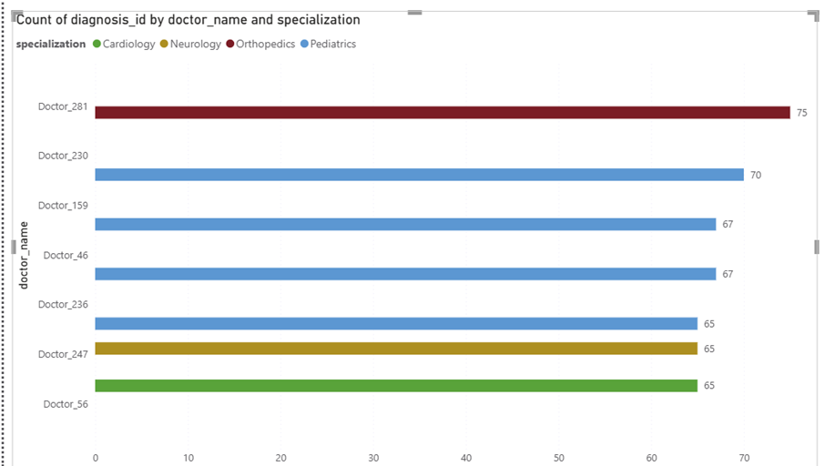
Task 3 – Doctor Performance – Diagnosis Count
Business Question "Which doctors are diagnosing the most patients?“
Insights from This Output:
Top Diagnoser: Doctor_281 (Orthopaedics') with 75 diagnoses.
High Load in Paediatrics: Most top doctors are Paediatricians — suggests heavy workload in that specialty.
Balanced Performance: Cardiology also has strong presence (Doctors 56, 30, 262).

Slide 16
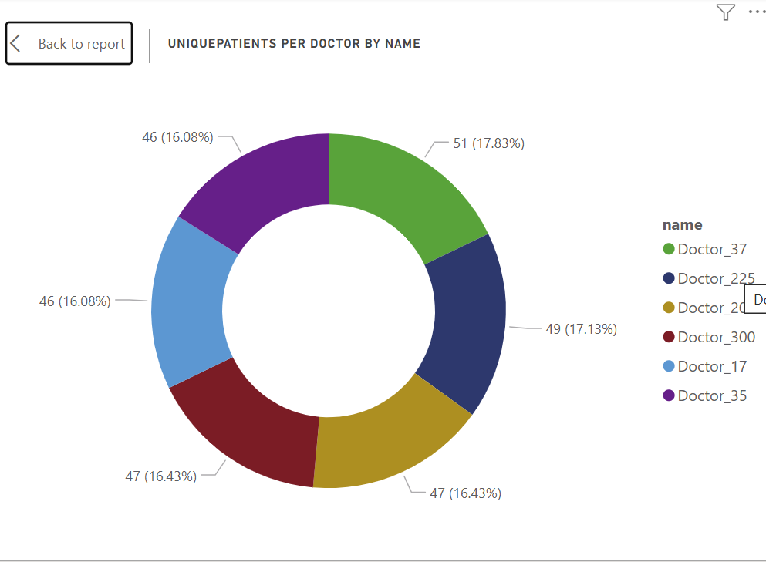
Top Doctors by Unique Patient Count
Business Insight:
Identified the doctor with the highest number of unique patients.
Highlights demand and popularity among patients based on their specialization and expertise.
Analysis Findings
Doctor with Most Unique Patients:
Name: Doctor_37
Specialization: General Medicine
Unique Patients: 51

Slide 17
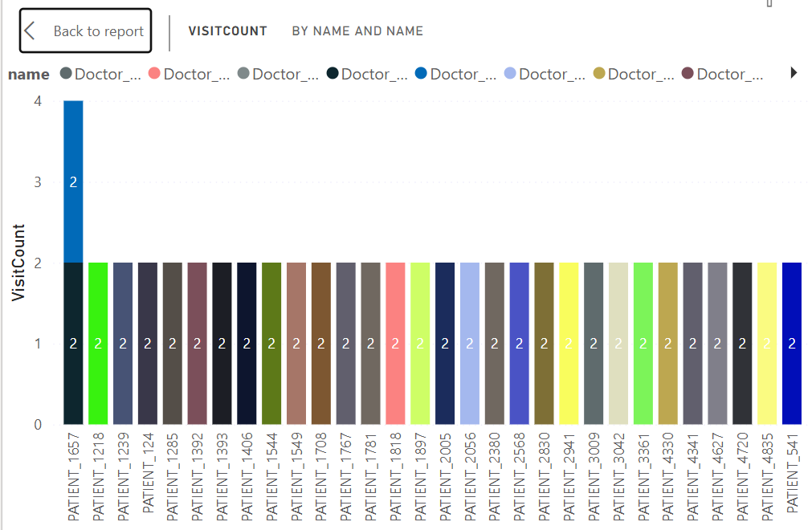
Rank Patients per Doctor
Shows which patients visited the same doctor most frequently.
Ranks patients by loyalty/frequency.
Helps track long-term patient relationships or potential overload.

Slide 18
Recommendation
🏅 Recognize and incentivize top-performing doctors.
🧑‍⚕️ Assign additional resources to doctors with high unique patient load.
👥 Investigate patients with frequent visits for chronic condition tracking.
🧾 Align scheduling to avoid overburdening high-demand doctors.

Slide 19
Scenario 3
Analyse Patient Demographics

Slide 20
Objectives
🎯 Business Question:
“How can we segment patients to understand key demographic trends for targeted healthcare initiatives?”
🧠 Business Objective:
Group patients by age and other attributes to identify patterns that can inform personalized care, outreach campaigns, and resource planning.
🔍 SQL Tasks Used in This Scenario:
Task No. | Description | SQL Concepts
Task 6 | Categorize patients by age group | CASE WHEN, GROUP BY
Task 10 | Filter patients by contact patterns (e.g., ending in 1234) | LIKE, UPPER()
Extra | (Optional) Gender-wise distribution | GROUP BY, COUNT()

Slide 21
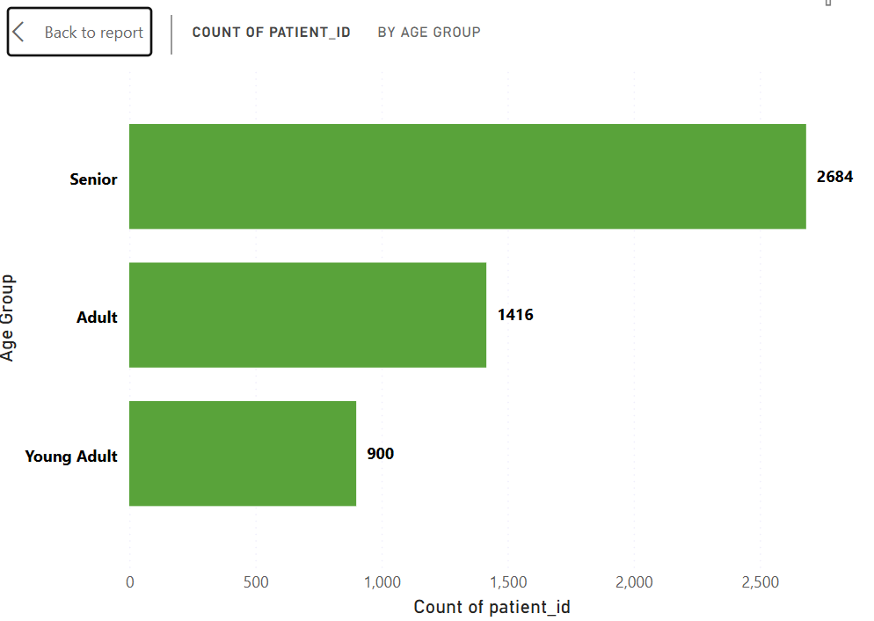
Patient Age Group Distribution
Age group | Patient count
Senior | 2684
Adult | 1416
Young Adult | 900
Insight: Shows which age groups dominate the hospital's patient base.
Majority of patients are senior, indicating focus needed on chronic disease care.

Slide 22
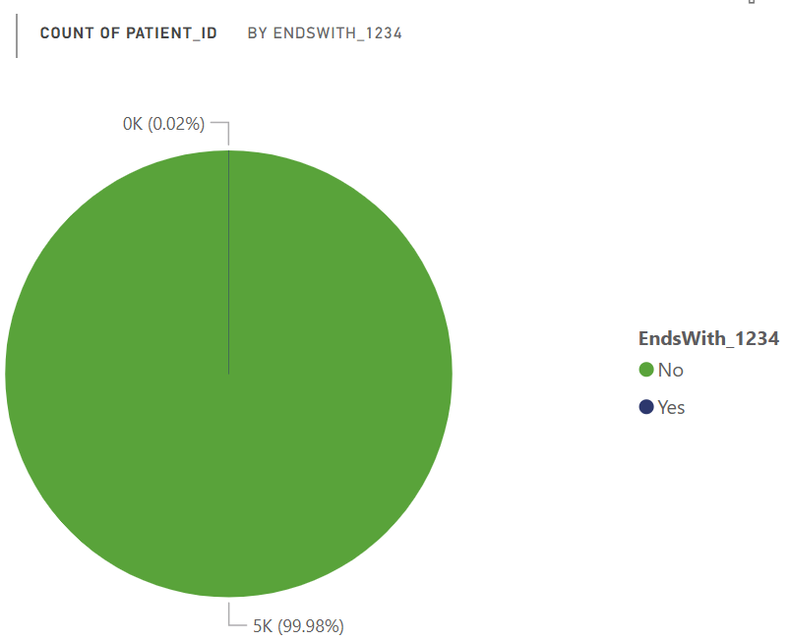
Contact Pattern Filter:
Objective
To identify patients whose contact numbers, end with “1234” and format their names in uppercase.
Data Validation & Quality Check
Pattern Detection for Communication Risk
Text Transformation Skill (UPPER)
Patient Name | Contact number
PATIENT_1234 | 98765431234

Slide 23
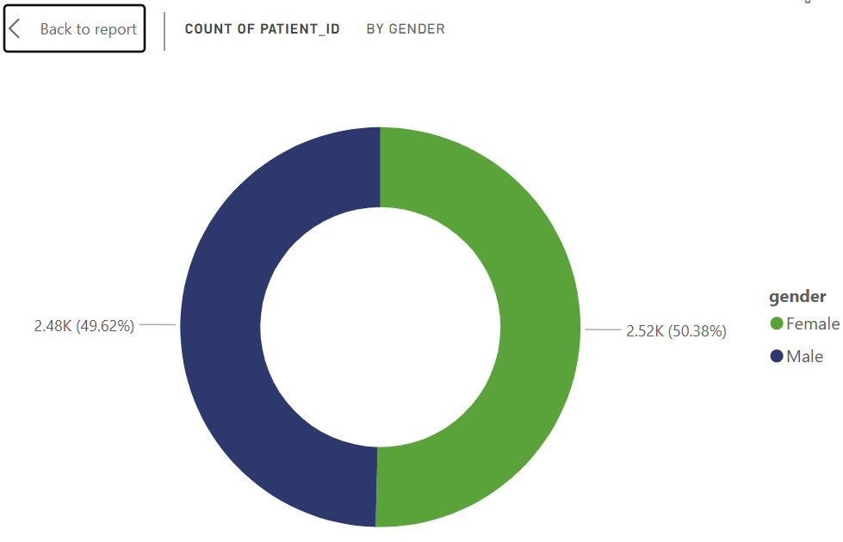
Gender-wise Patient Count:
Insight: Understand gender ratio to tailor services or outreach programs.
Gender | Count
Male | 2481
Female | 2519

Slide 24
Recommendation
Launch targeted health programs for adults and young adults based on age group insights.
Promote senior care services to improve healthcare access for elderly patients.
Implement gender-specific wellness initiatives based on gender distribution data.
Clean and validate contact numbers to ensure effective patient communication.
Use age and gender segmentation for personalized health campaigns and reminders.

Slide 25
Scenario 4
Medication & Treatment Optimization

Slide 26
Objective
Business Question:
How can we analyze medication usage and treatment durations to optimize patient care and inventory?
Business Objective:
Identify prescription trends and monitor treatment durations to support better resource planning and patient outcomes.
🔍 SQL Tasks Used:
Task No. | Description | SQL Concepts
Task 7 | Patients prescribed only "Insulin" | Subquery
Task 8 | Average duration of medication (in days) | DATEDIFF() + GROUP BY
Extra | Most prescribed medication per diagnosis | GROUP BY, COUNT()

Slide 27

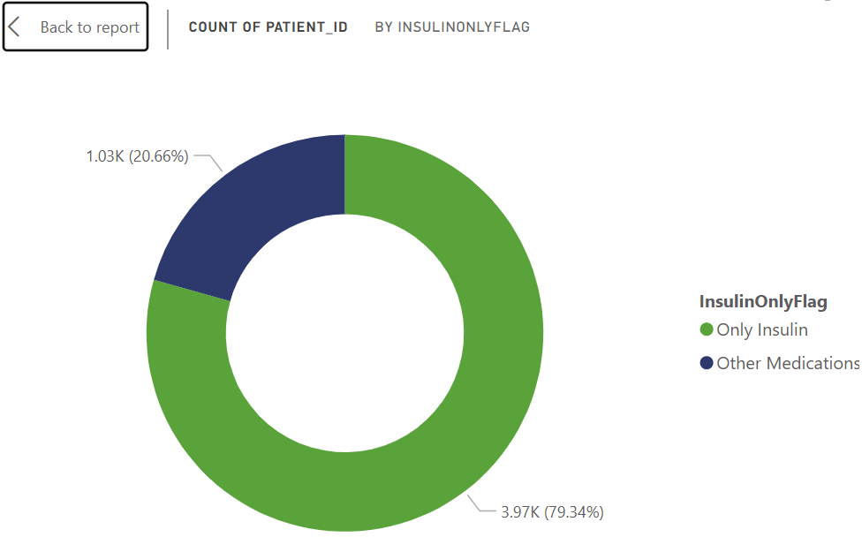
Patients prescribed only "Insulin"
🔍 Goal:
Show a list of patients who are only prescribed Insulin and nothing else.
To isolate high-dependency insulin users for targeted diabetic care programs.
Business Insight:
Can indicate lack of combination therapy — may require medical reassessment.

Slide 28
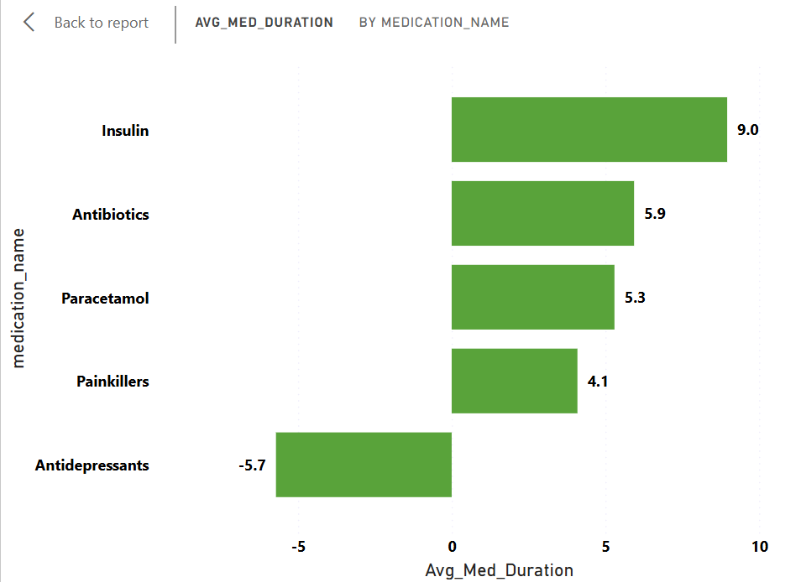
Average Medication Duration
Objective
Calculate how long (in days) each medication was prescribed on average.
Longer durations imply chronic illnesses or prolonged treatments
Helps in forecasting inventory needs and follow-up schedules.
Identify medications with long treatment windows — useful for pharmacy stocking.

Slide 29

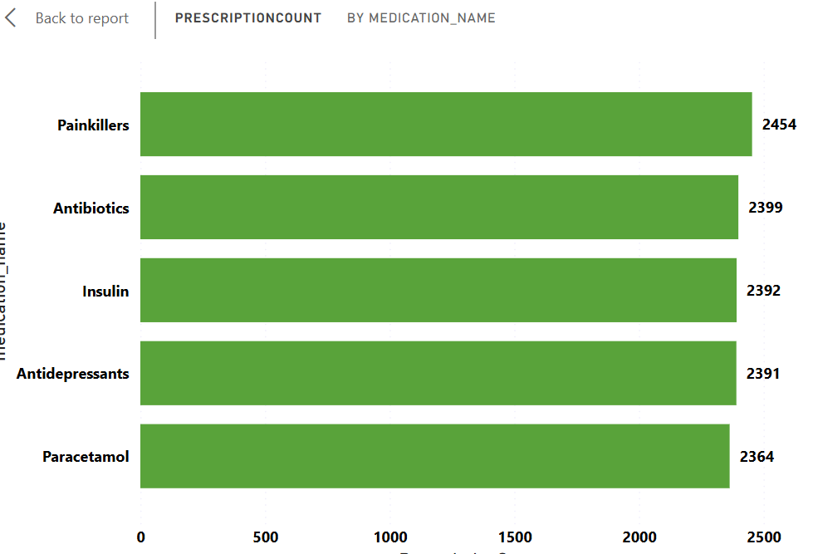
Most Common Medication
Objective:
Find out which medications are most frequently prescribed across all diagnoses.
Highlights the top medications the healthcare centre relies on.
Ensures sufficient stock and tracks overprescription trends.
Top 5 medications and their prescription counts.
May reveal overused medications, needing clinical policy review.

Slide 30
💡 Recommendations
Optimize insulin inventory for patients on long-term prescriptions.
Monitor long-duration treatments to track chronic conditions effectively.
Streamline high-frequency medications to ensure consistent stock availability.
Introduce prescription alerts for prolonged treatment durations.

Slide 31
Thank you

